Slide 1
Bayesian Networks
A. Darwiche

Slide 2
Bayesian Network
Battery Age
Alternator
Fan Belt
Charge Delivered
Battery
Fuel Pump
Fuel Line
Starter
Distributor
Gas
Battery Power
Spark Plugs
Gas Gauge
Radio
Lights
Engine Turn Over
Engine Start
A. Darwiche

Slide 3
Bayesian Network
Battery Age
Alternator
Fan Belt
Charge Delivered
Battery
Fuel Pump
Fuel Line
Starter
Lights
Distributor
Gas
Battery Power
ON
OFF
OK
.99
Spark Plugs
.99
.01
Gas Gauge
Battery Power
.20
.80
WEAK
Lights
DEAD
0
1
Engine Start
Radio
Engine Turn Over
θ₁ + θ₂ = 1
Pr(Lights=ON | Battery-Power=OK) = .99
A. Darwiche

Slide 4
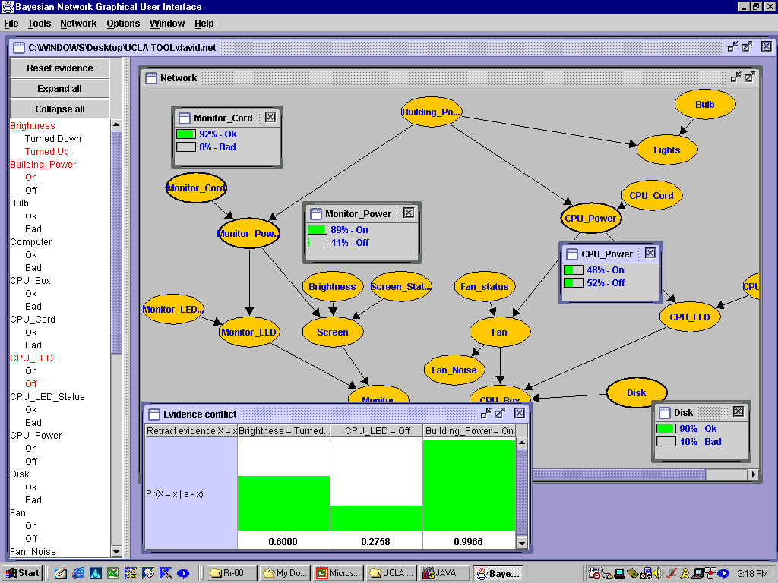
A. Darwiche

Slide 5
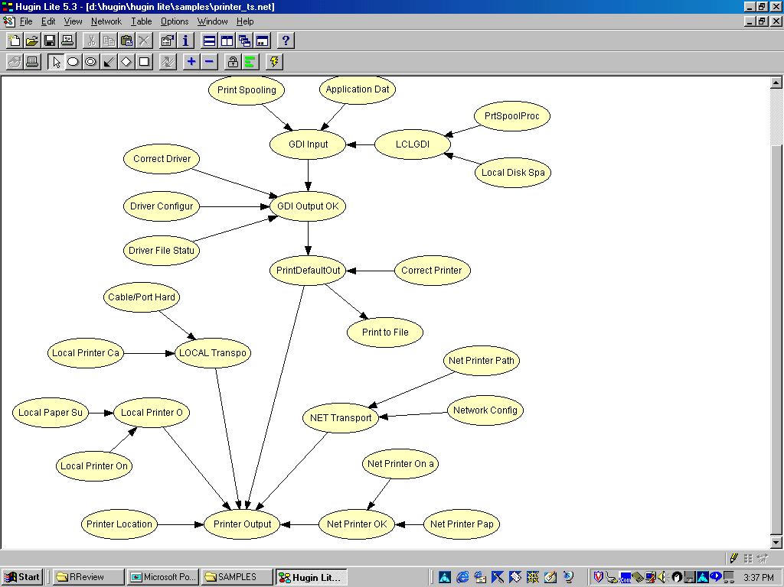
A. Darwiche

Slide 6
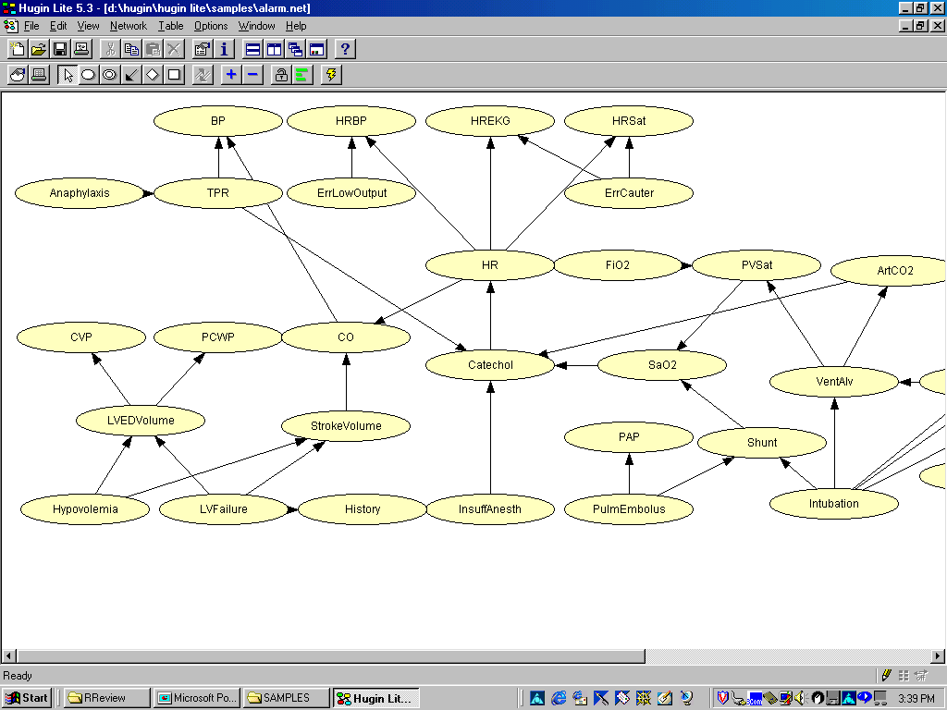
A. Darwiche

Slide 7
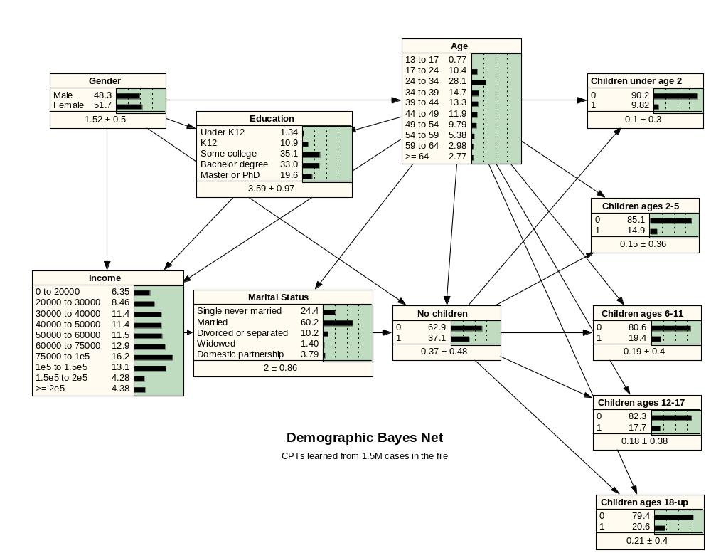
A. Darwiche

Slide 8
A Bayesian Network
Compact representation of a probability
distribution:
  Complete model
  Consistent model
Embeds many independence assumptions:
  Faithful model
A. Darwiche

Slide 9
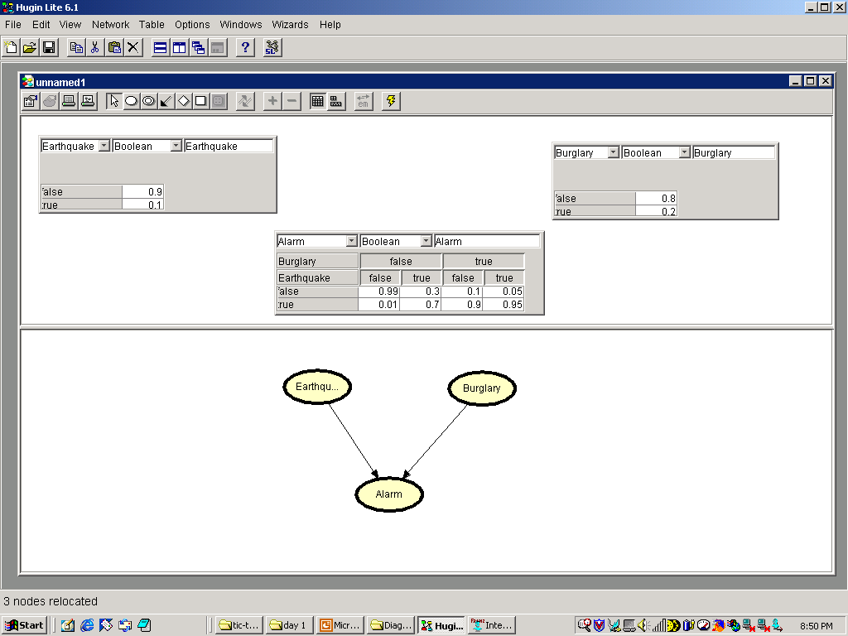
A. Darwiche

Slide 10
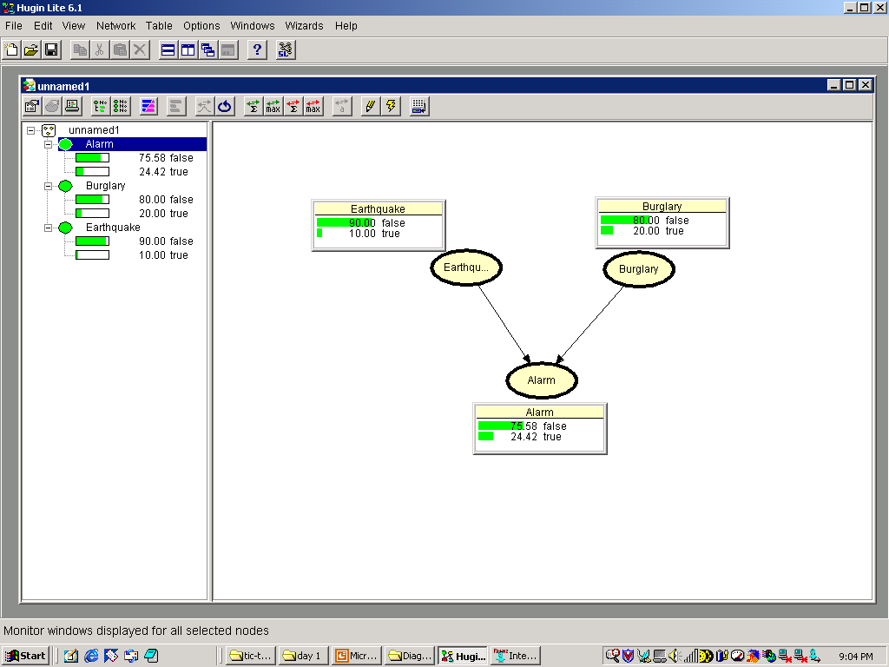
A. Darwiche

Slide 11
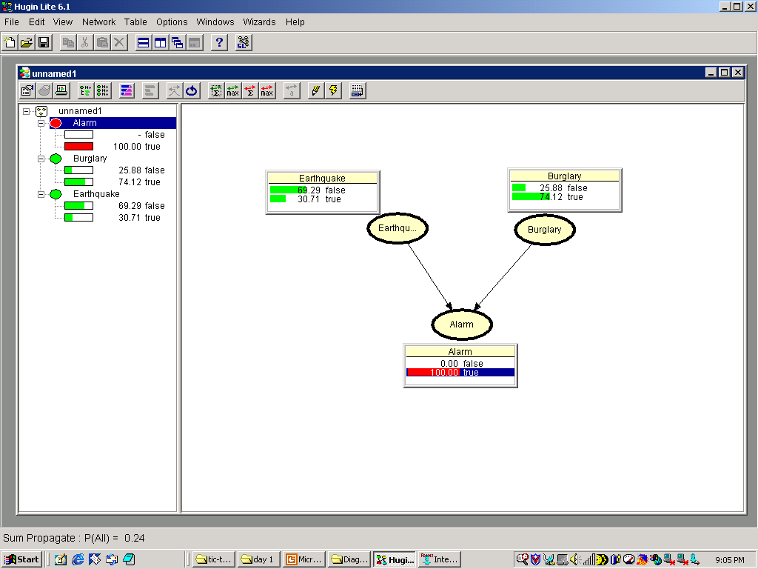
A. Darwiche

Slide 12
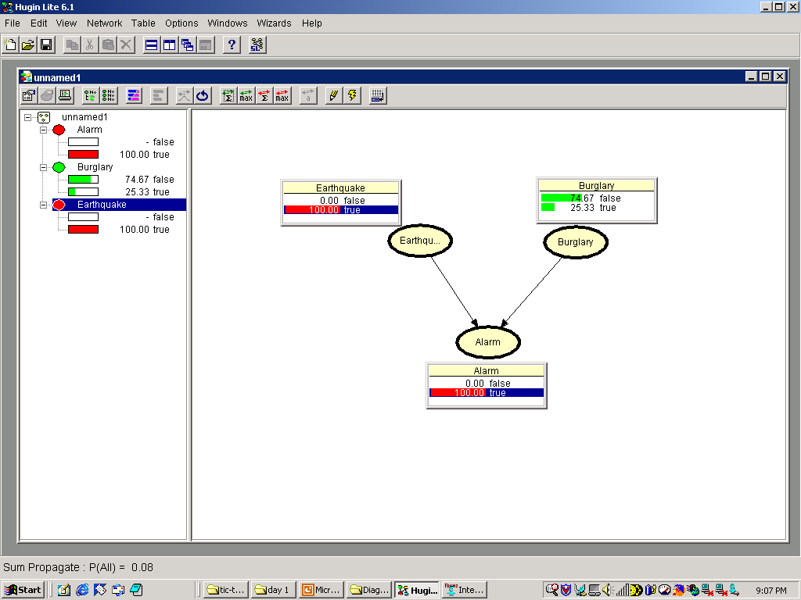
A. Darwiche

Slide 13
A Bayesian Network
Compact representation of a probability
distribution:
  Complete model
  Consistent model
Embeds many independence assumptions:
  Faithful model
A. Darwiche

Slide 14
Bayesian Network
Pr(E=true) | Pr(E=false)
.1 | .9
Pr(B=true) | Pr(B=false)
.2 | .8
Earthquake (E)
Burglary (B)
 | Pr(A=true) | Pr(A=false)
E=true, B=true | .95 | .05
E=false, B=true | .9 | .1
E=true, B=false | .7 | .3
E=false, B=false | .01 | .99
Alarm (A)
A. Darwiche

Slide 15
Joint Probability Distribution
E | B | A | Pr(.)
True | True | True | .019
True | True | False | .001
True | False | True | .056
True | False | False | .024
False | True | True | .162
False | True | False | .018
False | False | True | .0072
False | False | False | .7128
A. Darwiche

Slide 16
Independence Assumptions of a Bayesian Network
A. Darwiche

Slide 17
Causal Structure
Chol
Test1
Test2
I(Test1,Test2 | Chol)
A. Darwiche

Slide 18
Causal Structure
Chol
Nurse
Test1
Test2
I(Test1,Test2 | Chol)
I(Test1,Test2 | Chol, Nurse)
A. Darwiche

Slide 19
Naïve Bayes
H
O1
O2
On
…
H: Disease
O1, …, On: Findings (symptoms, lab tests, …)
A. Darwiche

Slide 20
Genetic Tracking
G1
G2
G5
G3
G4
G6
G7
G8
P4
Each node is independent of its non-descendants given its parents
A. Darwiche

Slide 21
Genetic Tracking
G1
G2
G5
G3
G4
G6
G7
G8
P4
Each node is independent of its non-descendants given its parents
A. Darwiche

Slide 22
Genetic Tracking
G1
G2
G5
G3
G4
G6
G7
G8
P4
Each node is independent of its non-descendants given its parents
A. Darwiche

Slide 23
Dynamic Systems
S1
S2
S3
S4
S5
O1
O2
O3
O4
O5
Each node is independent of its non-descendants given its parents
A. Darwiche

Slide 24
Dynamic Systems
S1
S2
S3
S4
S5
O1
O2
O3
O4
O5
Each node is independent of its non-descendants given its parents
A. Darwiche

Slide 25
The chain rule for
Bayesian Networks
A. Darwiche

Slide 26
Pr(e)
Earthquake (E)
Burglary (B)
Pr(b)
Alarm (A)
Pr(a|eb)
Pr(r|e)
Radio (R)
Call (C)
Pr(c|a)
Pr(craeb)=
Pr(c|raeb)Pr(r|aeb)Pr(a|eb)Pr(e|b)Pr(b)
Pr(c|a)
Pr(r|e)
Pr(a|eb)
Pr(e)
Pr(b)
A. Darwiche

Slide 27
Example: Build Joint Probability Table
Pr(E=true) | Pr(E=false)
.1 | .9
Pr(B=true) | Pr(B=false)
.2 | .8
Earthquake (E)
Burglary (B)
 | Pr(A=true) | Pr(A=false)
E=true, B=true | .95 | .05
E=false, B=true | .9 | .1
E=true, B=false | .7 | .3
E=false, B=false | .01 | .99
Alarm (A)
A. Darwiche

Slide 28
Temperature/Sensors
Temperature:
high (20%), low (10%), nominal (70%)
3 Sensors (true, false):
true (90%) given high temperature
true (1%) given low temperature
true (5%) given nominal temperature
A. Darwiche

Slide 29
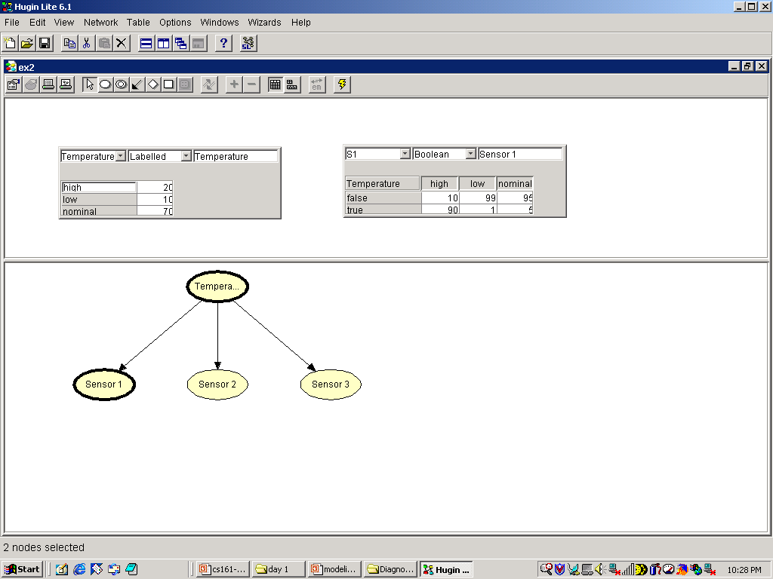
A. Darwiche

Slide 30
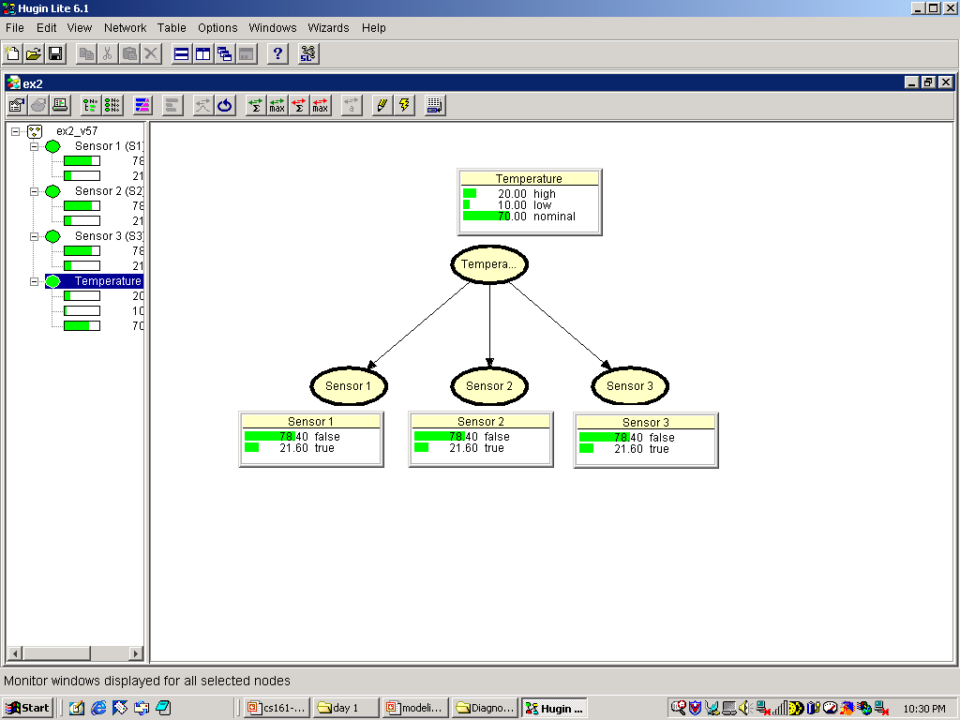
A. Darwiche

Slide 31
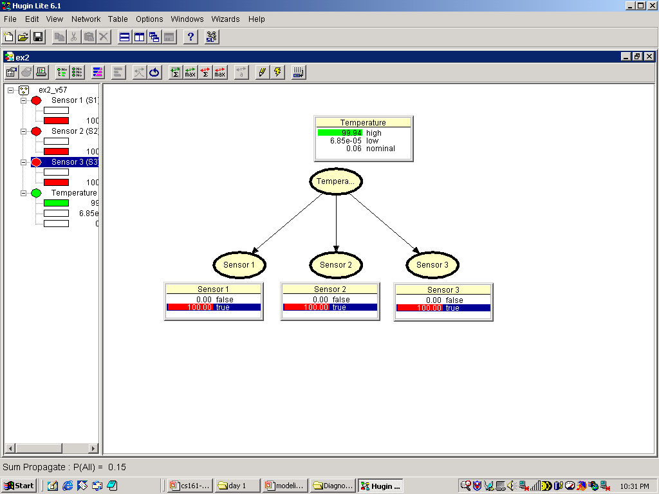
A. Darwiche

Slide 32
Queries
Pr(Sensor1=true)?
Pr(Temperature=high | Sensor1=true)?
Pr(Temperature=high | Sensor1=true,
Sensor2=true, Sensor3=true)?
A. Darwiche

Slide 33
d-separation
A. Darwiche

Slide 34
Earthquake (E)
Burglary (B)
… (F)
Alarm (A)
Radio (R)
Call (C)
Is A Independent of R given E?
A. Darwiche

Slide 35
Earthquake (E)
Burglary (B)
Alarm (A)
Radio (R)
Call (C)
Chain Link
…Active!
E & C not d-separated
A. Darwiche

Slide 36
Earthquake (E)
Burglary (B)
Alarm (A)
Radio (R)
Call (C)
Chain Link
…Blocked!
E & C are d-separated by A
A. Darwiche

Slide 37
Earthquake (E)
Burglary (B)
Alarm (A)
Radio (R)
Call (C)
Divergent Link
…Active!
R & A not d-seperated
A. Darwiche

Slide 38
Earthquake (E)
Burglary (B)
Alarm (A)
Radio (R)
Call (C)
Divergent Link
…Blocked!
R & A d-separated by E
A. Darwiche

Slide 39
Earthquake (E)
Burglary (B)
Alarm (A)
Radio (R)
Call (C)
Convergent Link
…Blocked!
E & B d-seperated
A. Darwiche

Slide 40
Earthquake (E)
Burglary (B)
Alarm (A)
Radio (R)
Call (C)
Convergent Link
…Active!
E & B not d-separated by A
A. Darwiche

Slide 41
Earthquake (E)
Burglary (B)
Alarm (A)
Radio (R)
Call (C)
Convergent Link
…Active!
E & B not d-separated by C
A. Darwiche

Slide 42
Earthquake (E)
Burglary (B)
Active
Blocked
Alarm (A)
Radio (R)
Call (C)
Are B & R d-separated by E & C ?
A. Darwiche

Slide 43
Earthquake (E)
Burglary (B)
Active
Alarm (A)
Radio (R)
Active
Call (C)
Are C & R d-separated ?
A. Darwiche

Slide 44
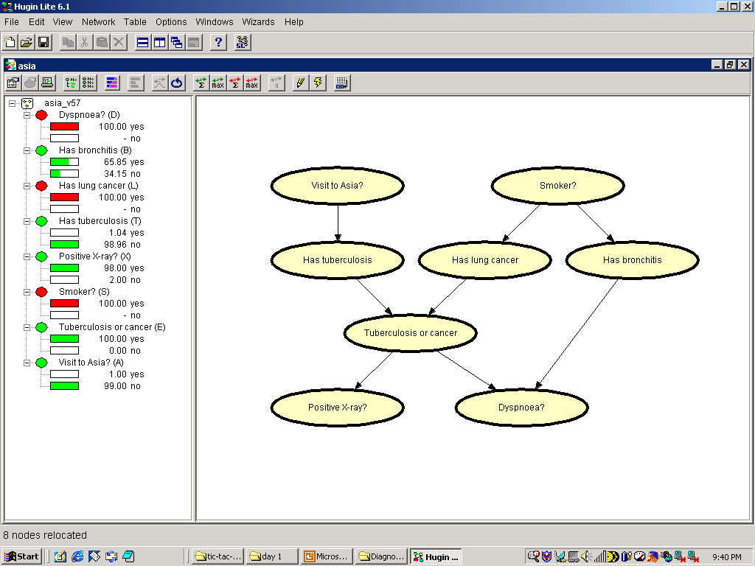
blocked
active
blocked
A. Darwiche

Slide 45
d-separation
Nodes X are d-separated from nodes Y
by nodes Z iff every path from X to Y is
blocked by Z.
A path is blocked by Z if some link on the
path is blocked:
  For some →X→ or ←X→, X in Z
  For some →X←, neither X nor one of its
  descendents in Z
A. Darwiche

Slide 46
d-separation in Asia Network
Visit to Asia / Smoker:
  No evidence: No
  Given TB-or-Cancer: Yes
  Given +ve X-Ray: Yes
Visit to Asia / +ve X-ray:
  No evidence: Yes
  Given TB: No
  Given TB-or-Cancer: No
Bronchitis / Lung Cancer:
  No evidence: Yes
  Given Smoker: No
  Given Smoker and Dysnpnoea: Yes
A. Darwiche

